Slide 1
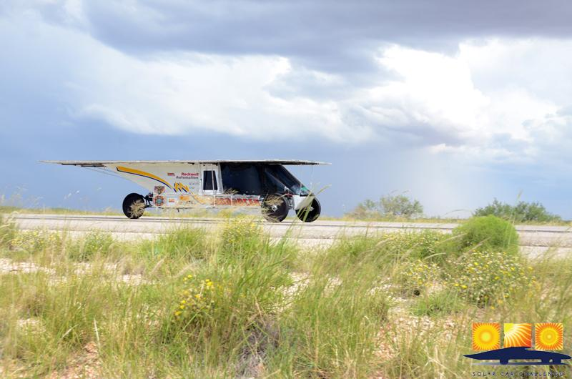
Things to Remember on a cross-country Race

Slide 2
We are all ambassadors of this solar car race . . . we represent our teams, our schools, and our sport. Take time to visit with “the curious.”
It helps to designate one of your team members as a Public Information Officer. Let this person visit with bystanders

Slide 3
You will start and end the day with your Race Judge. You are responsible for their meals & well-being. They sit in the Chase Car Passenger Seat.
Treat your judge with respect and cooperation. Designate one of the team members to be a liaison to promote good judge/team communication.

Slide 4
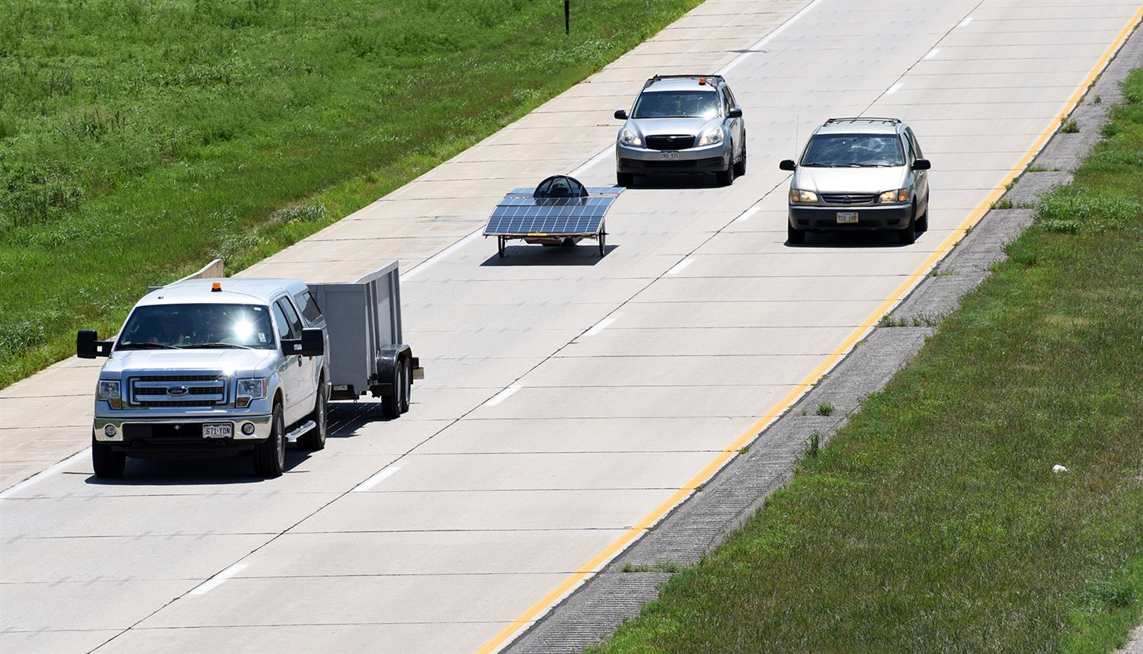
Keep your judge informed about your plans. A question asked before you do something “unwise” is always better than a penalty.

Slide 5
Be on time!
(1) Be on time for the 8:00 AM Drivers’ Meeting
(2) Be ready to line up your car according to starting order
(3) Be on time for meals
Teams arriving after the stated time in the “Where-to-Be” document are responsible for their own meals.

Slide 6
Be careful about what you say in public. Bystanders have been offended by thoughtless comments.

Slide 7
Driving Procedure Be sure to take part in all Lunch Stops, Media Stops, and Displays. If racing instructions indicate that solar cars will be driving into a Lunch Stop or Media, do you best to drive in to the “stop.” Visitors rarely get excited seeing a solar car on a trailer

Slide 8
Passing Pass another solar car with great care. Remember your vehicles have to pass all the other team’s vehicles! If you have any kind of driving problem, tell your judge immediately

Slide 9
The Primary Chase Vehicle must always stay with the solar car. Failure to do this will endanger the solar car and driver. It is crucial that teams closely monitor their driving through intersections. If a team doesn’t think that the solar car and primary chase vehicle can make it through a light, then don’t do it! Don’t leave your solar car exposed.

Slide 10
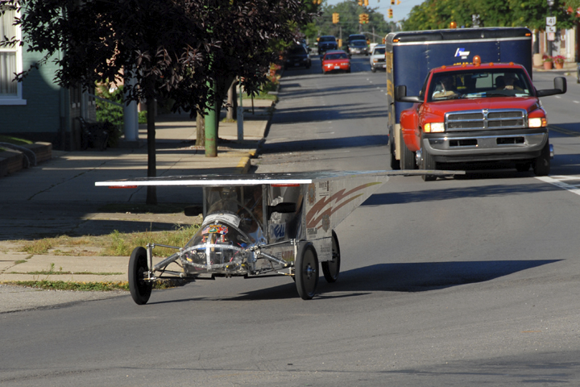

Slide 11
WARNING LIGHTS Make sure the Lead Car has a significant amber blinking light. Make sure that each of the two Chase Cars have 4 ECCO lights facing to the rear!

Slide 12
Student Conduct Students should conduct themselves properly at all times. This includes our time at the hotels. We place great emphasis on good sportsmanship!

Slide 13
Safety Issues We have to realize that onlookers, drivers, and media can drive in an unsafe manner just to get a better look at a moving solar car. They are our paparazzi! Teams need to drive defensively. Make sure that your Lead Car-Solar Car-Primary Chase Vehicle drive as a “unit.” Don’t allow an unsafe driver to cut in between the solar car and the Lead Car or Chase Car.

Slide 14
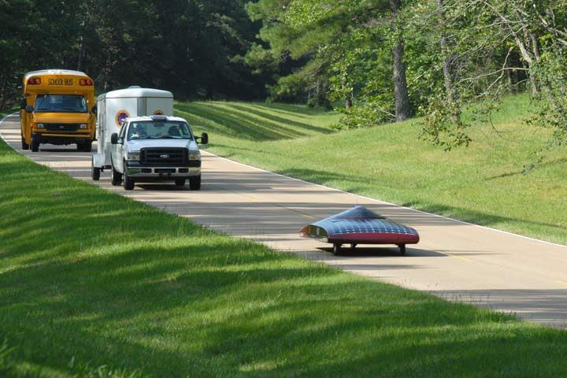

Slide 15
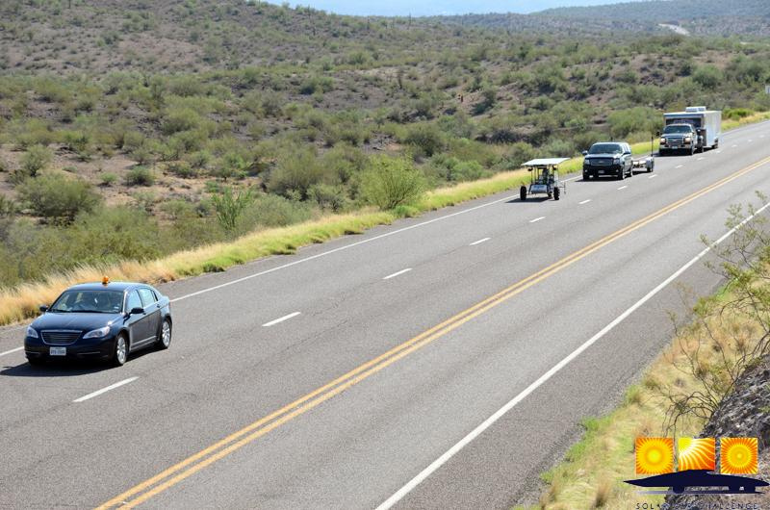

Slide 16
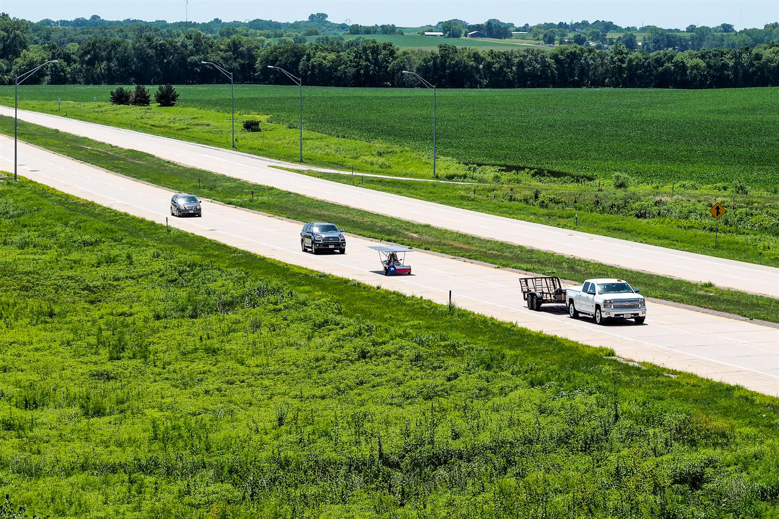

Slide 17
Continually monitor your solar car driver for heat issues. Rotate your drivers frequently! All race participants must wear hats when in the sun. Solar car drivers must wear shoes and have a hat available!

Slide 18
The race recognizes that the ultimate responsibility for driving, team actions, and student conduct rests with the Adviser and/or School Representative. Having said this, the Race expects teams to follow the safety requests by Race Officials. If any request appears to be too burdensome, teams are authorized to contact the Race Director for clarification

Slide 19
Impound Issues Don’t remove a solar car from the Impound without a judge being present. Your judge will be checking the following points each race morning: (a) Battery seals and secure connections (b) Driver Communication (c) Brake lights and turn signals (d) Safety Officer has necessary equipment (e) Chase vehicle lights

Slide 20
A Typical Race Day 6:30 AM Impound Opens [teams meet judge and get access to solar car] 8:00 AM Required Teams Meeting at Official Trailer 8:45 AM Solar Cars are lined up ready for Race Start 9:00 AM Race Start 10:30 AM Media or Rest Stop [15 minutes required] 12:30 PM Lunch Stop [30 minutes required] 2:30 PM Media or Rest Stop [15 minutes required] 5:00 PM Race Day Ends [trailer solar car if not at “end-of-race”] 7:00 PM Meal together with other teams 9:00 PM Impound begins [no access to solar cars]

Slide 21
